Slide 1
C28 LFU
Nov 2022

Slide 2
Agenda
LFU without reset on F28003x
C28x/CLA
Compiler support
F28003x hardware support for LFU
LFU with reset on F28003x
Skipping updates during LFU
Concerns/Issues

Slide 3
LFU without reset on F28003x

Slide 4
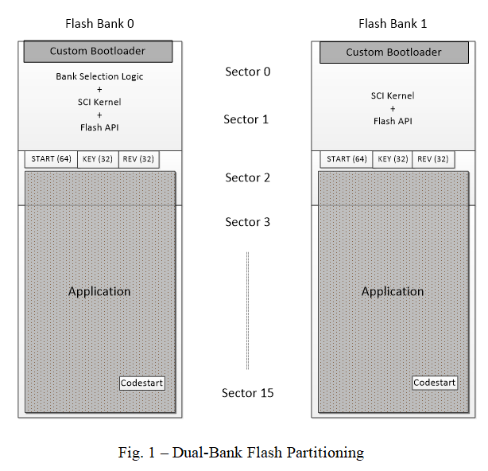
C28x LFU Flow – Bank 0 to Bank 1
Both Flash banks are Active
Host initiates LFU, CommandLogISR() registers command
RunLFU() parses LFU command, branches to Custom bootloader. Real-time interrupts still enabled
Bootloader downloads the new Firmware image from the host (e.g. over SCI) and erases/programs new Application image in other Flash bank
LFU command
0x80000
0x90000
3
2
1
0x858b6
RunLFU
RunLFU
0x8517a
CommandLogISR
CommandLogISR
Notes:
The picture in the slide assumes Flash bank 0 is executing, and Flash bank 1 is being updated.
The Flash banks are programmed, at production time, with both a Custom bootloader (which is unaffected by LFU), and an Application firmware.
Typically the custom bootloader will take up 1-2 Flash sectors of the Flash bank.
When the device starts up, execution begins in the Custom bootloader bank selection logic. This logic checks certain fields (like the START, KEY, REV) to determine whether there is a valid Application present in that specific Flash bank.
If there is a valid Application image in both Flash banks, it compares the REV (revision/version) field to determine which one to execute.
RunLFU() is a background function. When Custom bootloader is executing and downloading and programming the new application image, real-time ISRs continue to run

Slide 5
C28x LFU Flow
Both Flash banks are Active
Bootloader branches to fixed-address LFU entry point (c_int_lfu) of new application
Set LFU Flag in HW register, call LFU compiler initialization routine (__TI_auto_init_warm) for new application which executes in tandem with old application’s ISRs
No time constraint on __TI_auto_init_warm
Main() called
0x80000
0x84e22
0x94e53
main()
main()
6
4
0x9568c
0x855ed
__TI_auto_init_warm
__TI_auto_init_warm
5
0x8eff8
C_int_lfu
0x9eff8
C_int_lfu
0x8eff0
0x9eff0
Notes:
Each application should contain a fixed address LFU entry point that the custom bootloader can branch to.
The compiler RTS library provides a LFU initialization routine. When the application firmware is built, the previous application executable is provided as a reference to the compiler.
This allows the compiler to recognize common variables and avoid moving their address or initializing them (maintaining state) in __TI_auto_init_warm.
__TI_auto_init_warm will only initialize variables the user explicitly indicates need to be initialized (by default, these are the non-common/new variables present in the new application).

Slide 6
C28x LFU Flow
Both Flash banks are Active
In main(), LFU flag in HW register checked. Since set, Init_lfu performs Flash to RAM code copy (if any), updates “inactive” interrupt vectors and Function pointers
No time constraint on init_lfu either
IdentifyIdleTime determines the exact end of an ISR
ActivateApp activates new firmware by activating the “inactive” interrupt vectors and function pointers
Global interrupts disabled only for this step
Only this step is time critical
main()
0x94e53
main()
8
7
init_lfu
Init_lfu
0x954d0
IdentifyIdleTime
9
IdentifyIdleTime
ActivateApp
ActivateApp
Notes:
Updating Interrupt vectors and Function pointers happens in this step with the assumption that device hardware supports “Swapping” i.e. similar to Flash, an Active portion and an Inactive portion.
TI MCUs for LFU support this feature. Therefore, in this step, the Inactive portion is updated.
Logic that looks for the end of an ISR, helps maximize IDLE time usage.
Activating the “inactive” interrupt vectors and function pointers occurs in one CPU clock cycle each, since it is just a memory swap operation.

Slide 7
CLA LFU Flow
Both Flash banks are Active
Init_lfu performs Flash to LSxRAM code copy, by first making CPU master, then after copy make CLA shared master. Also disable CLA background task
Wait for CLA background task to stop
LFU_setupCLALFU activates new firmware by initializing the MVECTs and background task, then re-enabling the background task
This is done in main()
Can be moved inside LFU_CLA_BGRND_ISR() to make C28x and CLA LFU switchover asynchronous
main()
0x94e53
main()
8
7
init_lfu
Init_lfu
0x954d0
CLA Background task stopped?
9
CLA Background task stopped?
LFU_setupCLALFU
LFU_setupCLALFU
Notes:
Updating Interrupt vectors and Function pointers happens in this step with the assumption that device hardware supports “Swapping” i.e. similar to Flash, an Active portion and an Inactive portion.
TI MCUs for LFU support this feature. Therefore, in this step, the Inactive portion is updated.
Logic that looks for the end of an ISR, helps maximize IDLE time usage.
Activating the “inactive” interrupt vectors and function pointers occurs in one CPU clock cycle each, since it is just a memory swap operation.

Slide 8
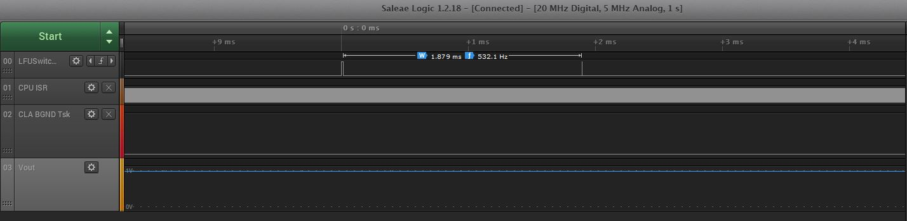
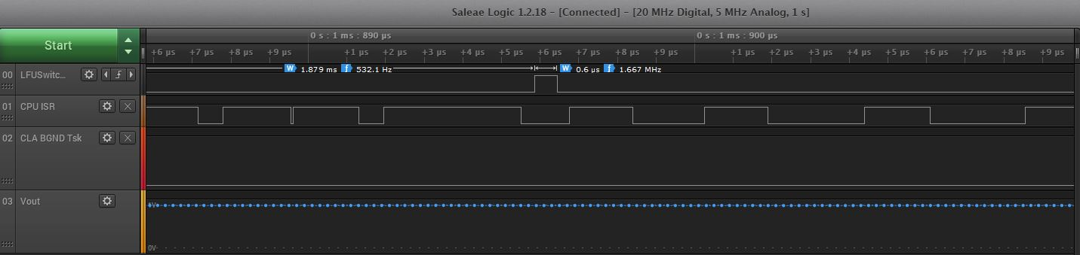
Results
__TI_auto_init_warm executes in tandem with ISR
Init_lfu time consuming because of memcpy()
Download firmware and program inactive Flash bank
ActivateApp occurs during Idle time
Old firmware ISR (longer)
New firmware ISR (shorter)
Output stays regulated
Notes:
Results are generated using TIDM-02011 ported to F28003x, which has hardware LFU features like support for interrupt vector swapping (active/inactive portions), and function pointer swapping (using RAM LS0/LS1 swapping).
CPU clock is 120MHz, 2 Flash banks are used, each 128KB.
Application is a DC-DC buck converter, to convert a 10V DC input to a regulated 2V DC output. There is a divide by 2, which is why the waveforms show Vout = 1V.

Slide 9
Compiler Support
__TI_auto_init_warm is the compiler LFU initialization routine
Old FW is provided as reference to compiler to build new FW
Compiler uses this old FW to recognize common variables between old and new FW, and keeps them at the same addresses and does not initialize them in its LFU init. routine (when --lfu_default = preserve, this is the default mode if nothing is specified)
Variable attributes supported by the compiler (“preserve” and “update”). In default mode, no need to explicitly provide attributes for Common variables. They are “preserve” by default.
New variables are assigned addresses by default, but are initialized by the Compiler LFU init. routine only if they have the “update” attribute

Slide 10
F28003x Hardware Support for LFU
C28x
PIE swapping for interrupt vectors
RAM swapping for function pointers
Define 2 sets of pointers e.g. A_Task_Ptr and A_Task_Ptr_Shadow using DATA_SECTION pragmas and allocate to RAM LS0, RAM LS1, at same relative locations
A_Task_Ptr is the “name” that is used in the source code
However, what it points to could be A_Task_Ptr (old FW) or A_Task_Ptr_Shadow (new FW) depending on whether RAMLS swap bit is enabled or not
So user application code has function pointers in RAM LS0 “address space”, but 2 different physical RAM blocks can map to that address space
In init_lfu(), we update A_Task_Ptr_Shadow e.g. A_Task_Ptr_Shadow = &A1;

Slide 11
LFU with reset on F28003x
Steps 1, 2, 3 same as LFU without reset
Macro LFU_WITH_RESET needs to be defined in SCI Flash kernel
This causes WD reset to occur after Step 3
LFU command
3
2
1
RunLFU
RunLFU
CommandLogISR

Slide 12
Cannot Skip Firmware Updates with LFU
Assume common variables between versions aren’t initialized, only new variables are allocated and initialized by the compiler’s LFU init. routine. This is the current default behavior of TI C2000 compiler for LFU.
Based on the above, assume each firmware was built using the previous as reference, and assume we are performing LFU and going from Version 0 directly to 3. The compiler will only allocate and initialize E, and since D is common to v2 and v3, it is not initialized. So if there’s a function in v3 that uses D, that function will begin operating on uninitialized D. This is an issue.
Even a simpler scenario where variables only get added will have the same issue. Going from v1 to v3 directly, will have uninitialized D.
Version | Variables present
0 | A, B, C
1 | A, B, C, D
2 | A, C, D
3 | A, C, D, E
Version | Variables present
0 | A, B,
1 | A, B, C,
2 | A, B, C, D
3 | A, B, C, D, E

Slide 13
Concerns/Issues
Flash bank swapping
Would likely also require update to LFU Compiler init. Routine (Can no longer run as in Step 5 of LFU flow).
2 image solution
Transmission time concern
Firmware management complexity (checksum bank0, bank1, bank0+1)
Design complexity (bank selection logic, data logging)

Slide 14
References
SPRUIU9 (3Q22)
TIDM-02011 (2Q22)
SPRACN0 (2Q22)
SPRUIU8 (2Q20)

